Slide 1
How We Segment Images
– Jacob Panikulam: Jan 22, 2014
Presentation devoid of OQULUS proprietary technical information

Slide 2
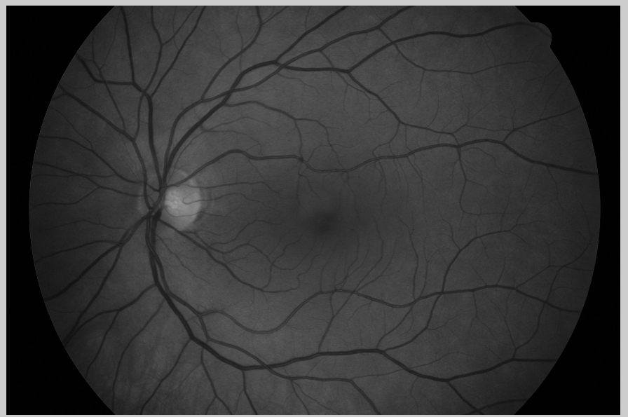
Start with the green layer

Slide 3
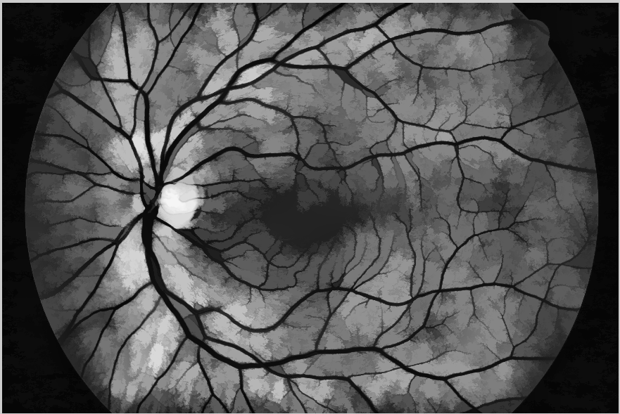
Perform Color-Compensation

Slide 4
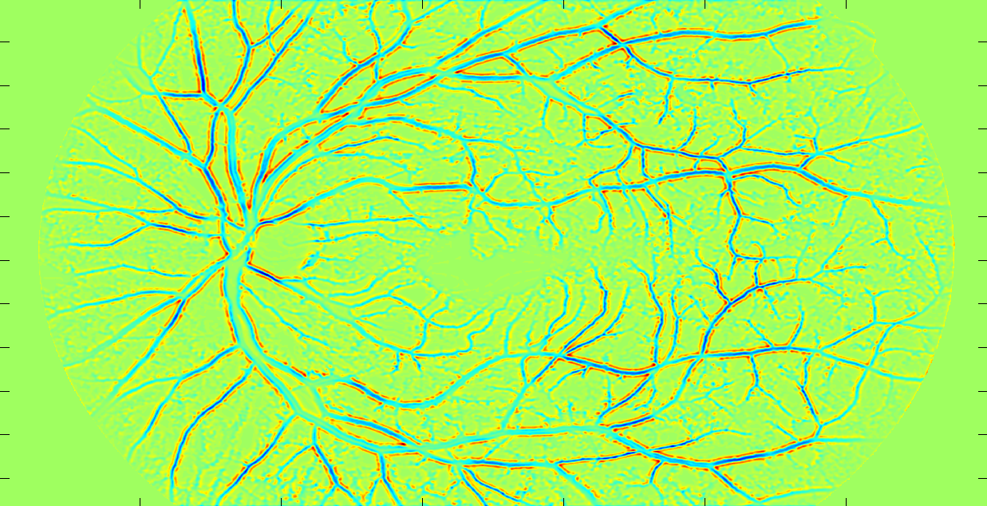
Apply Filters to Isolate Vasculature

Slide 5
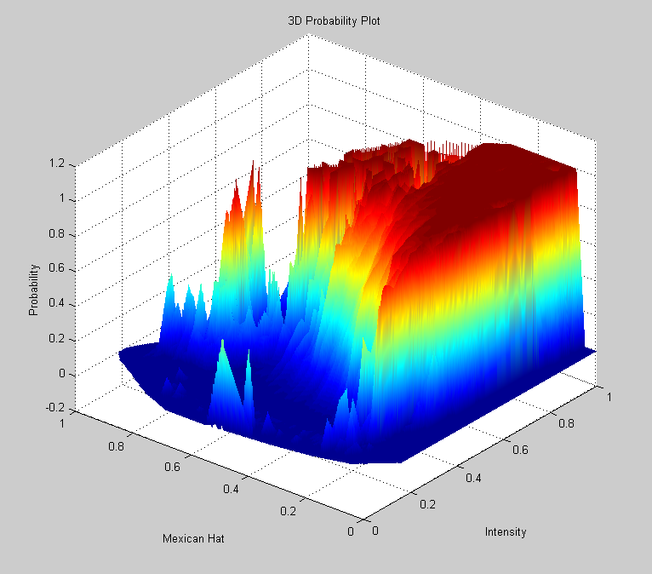
Determine Probabilities

Slide 6
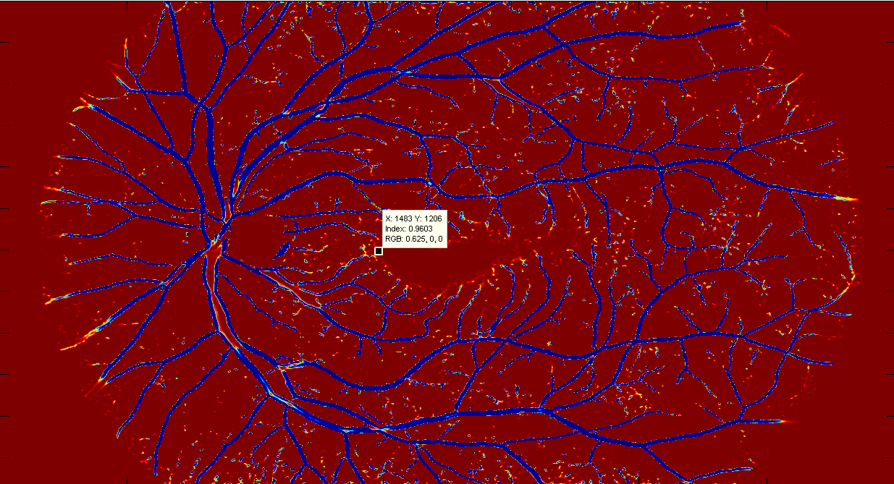
Create a Map of Probabilities

Slide 7
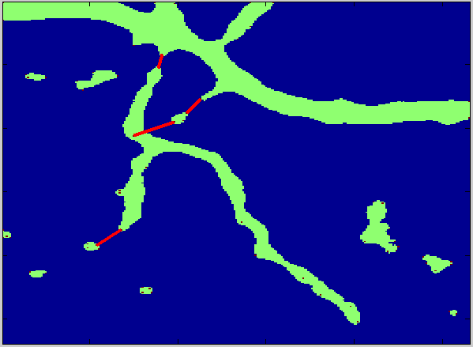
Find Discontinuities and Repair

Slide 8
Examples and Progress
The following segmentations were produced about two weeks apart

Slide 9
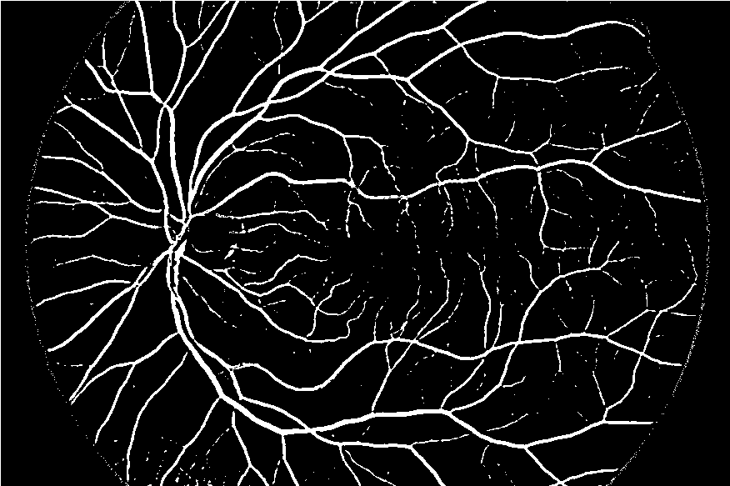
73 % Accuracy – Jan 2, 2014

Slide 10
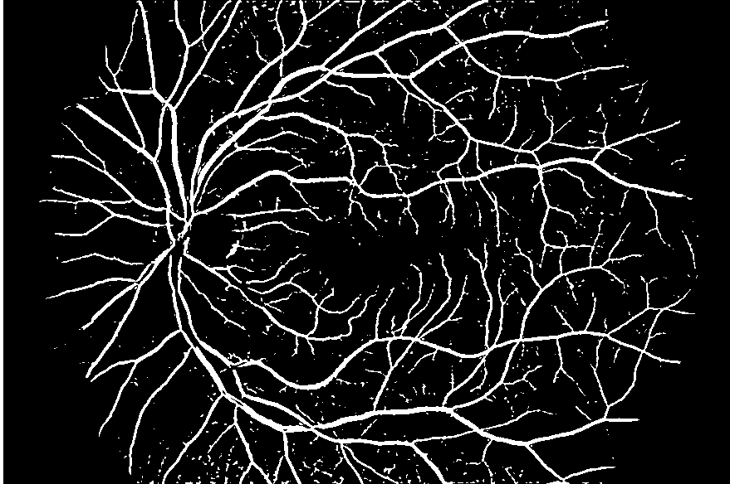
79% Accuracy – Jan 20, 2014

Slide 11
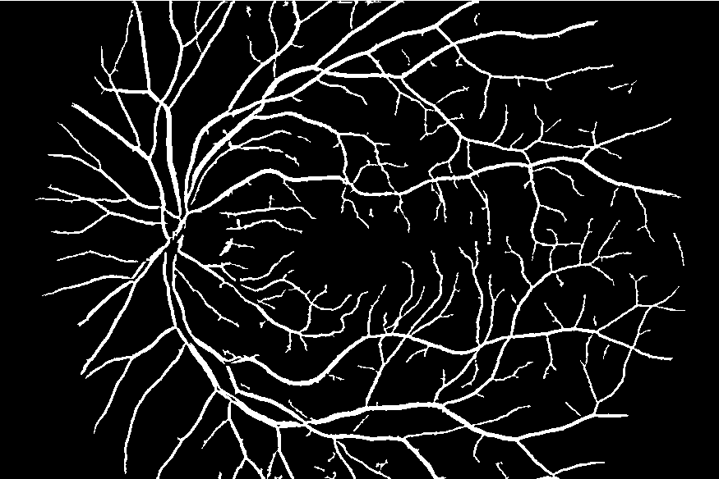
79% Accuracy, auto-cleaned

Slide 12
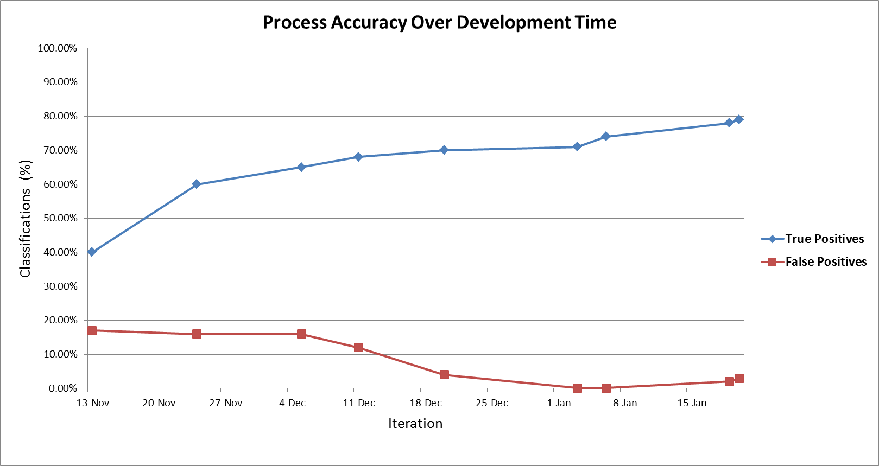
Accuracy Improvement Over Time

